Slide 1
Foreign Key
Kusal Bista

Slide 2
Shop model
class Shop(models.Model):
shop_name = models.CharField(max_length=255)
contact = models.BigIntegerField()
location = models.CharField(max_length=255)
category = models.CharField(max_length=255)
contact_person = models.CharField(max_length=255)
email = models.EmailField()
def __str__(self):
return self.shop_name

Slide 3
Adding Shop as a foreign key in Product model
class Product(models.Model):
Shop = models.ForeignKey(Shop, on_delete=models.CASCADE, null=True)
product_name = models.CharField(max_length=255)
price = models.IntegerField()
discount = models.FloatField()
old_price = models.IntegerField()

Slide 4
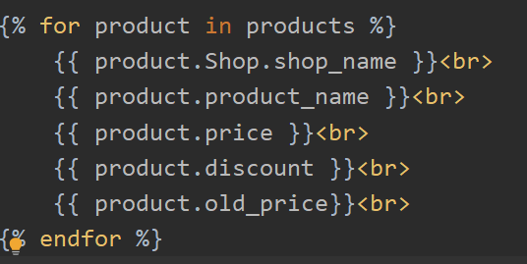
Next
Do the necessary migrations and add the following in template.
Shop detail is now accessed
through product.

Slide 5
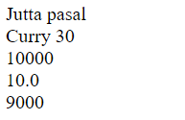
Template -index.html
Here, Jutta pasal is a shop name for a product Curry 30.

